Slide 1


BIG MART SALES PREDICTION

Slide 2
INTRODUCTION
The objective of this project is to forecast the sales data of big mart in a number of big mart stores across various location types which is based on the historical data of sales volume.

Slide 3
TECHNOLOGY USED
MACHINE LEARNING LIBRARIES
NUMPY
PANDAS
MATPLOTLIB
SEABORN
SKLEARN

Slide 4
MODULES
1.
DESCRIPTIVE STATISTICS
4.
FEATURE ENGINEERING
2.
DATA EXPLORATION
5.
MODEL BUILDING
3.
DATA CLEANING

Slide 5
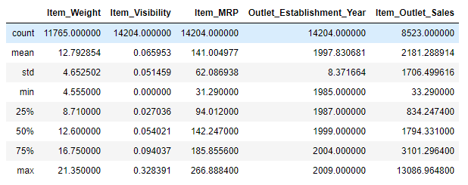
DESCRIPTIVE STATISTICS

Slide 6
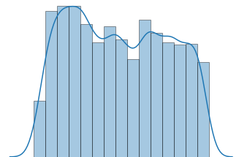
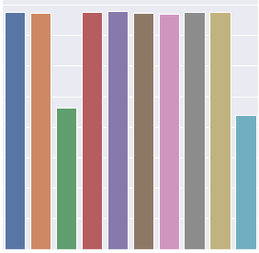
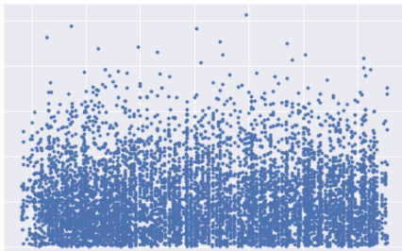
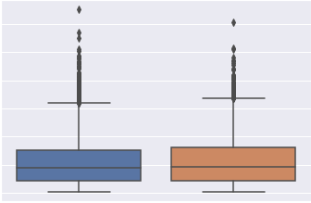
DATA EXPLORATION
UNIVARIATE ANALYSIS ON CONTINUOUS VARIABLES
UNIVARIATE ANALYSIS ON CATEGORICAL VARIABLES
BIVARIATE ANALYSIS BETWEEN CONTINUOUS
AND CONTINUOUS
VARIABLES
BIVARIATE ANALYSIS BETWEEN CONTINUOUS
AND CATEGORICAL VARIABLES

Slide 7
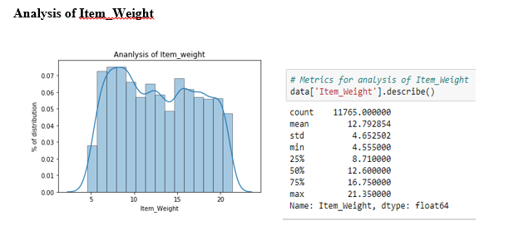
UNIVARIATE ANALYSIS ON CONTINUOUS VARIABLES

Slide 8
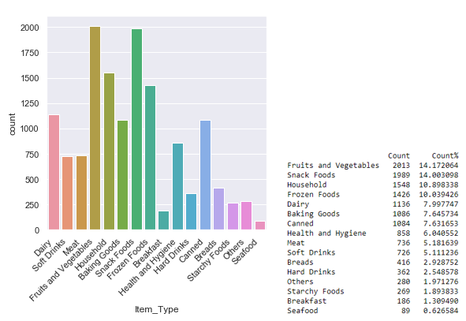
UNIVARIATE ANALYSIS ON CATEGORICAL VARIABLES

Slide 9
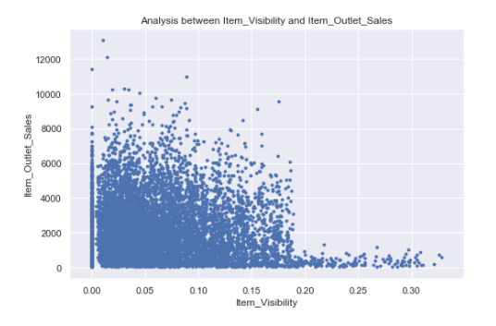
BIVARIATE ANALYSIS BETWEEN CONTINUOUS AND CONTINUOUS

Slide 10
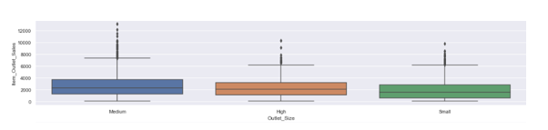
BIVARIATE ANALYSIS BETWEEN CONTINUOUS AND CATEGORICAL

Slide 11
DATA CLEANING
Treatment of missing values
Treatment of outliers

Slide 12
FEATURE ENGINEERING
Feature engineering is the science (and art) of extracting more information from existing data.

Slide 13
MODEL BUILDING
Various regression algorithms like linear regression, ridge regression, lasso resgression, decision tree and XGBoost are applied. Out of all algorithms, XGBoost performs the best.

Slide 14
THANK YOU

